Slide 1
Samsung Innovation Campus
Artificial Intelligence Course
Notes:
Note:

Slide 2
Heart Disease Prediction
AI Course
Notes:
Note:

Slide 3

Hunters Team
Ola El-Shiekh

Slide 4
Presentation Contents
slide | content
1:2 | Project name
3:4 | team
5 | Introduction
6:11 | Design thinking
12:23 | EDA
24:32 | Modelling
33:34 | API&GUI
35 | Thanks
Notes:
Note:

Slide 5
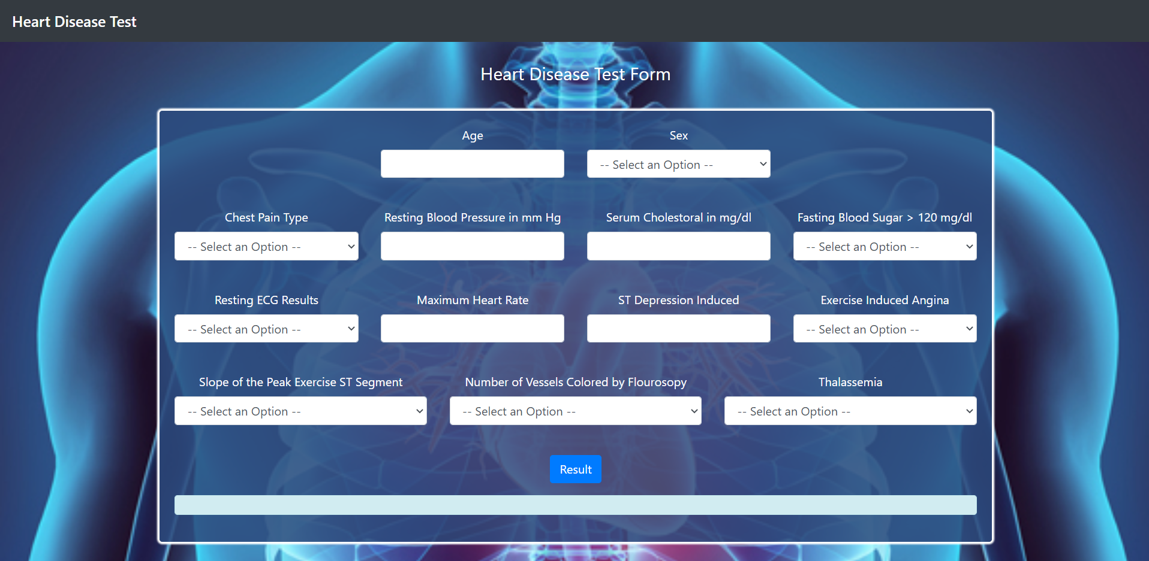
Introduction
World Health Organization has estimated 12 million deaths occur worldwide, every year due to Heart diseases. Half the deaths in the United States and other developed countries are due to cardiovascular diseases.
1

Slide 6
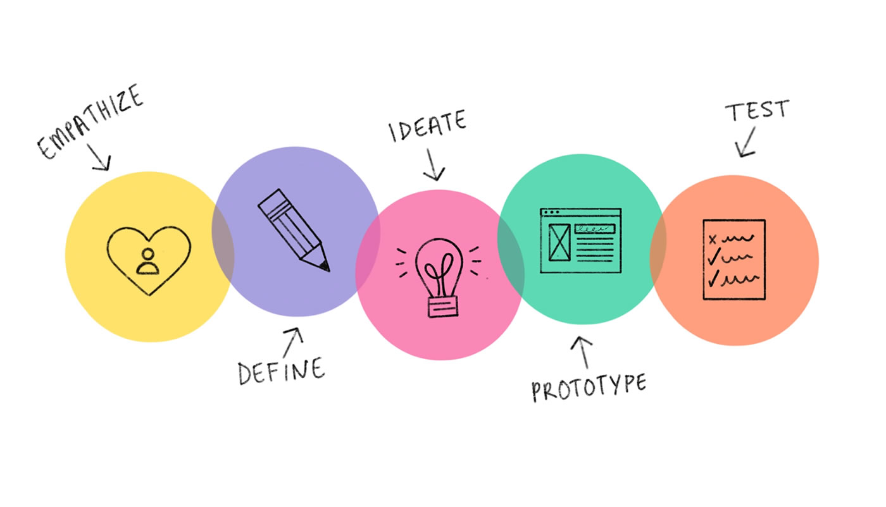

Design Thinking
2
Notes:
Note:

Slide 7

Empathize
Health care is the maintenance or improvement of health via the prevention, diagnosis, treatment, recovery, or cure of disease, illness, injury, and other physical and mental impairments in people.
The main core of this research analysis will
lead us to the early detection of Heart disease
to prevent it or have an early treatment.
3
Notes:
Note:

Slide 8
Define Problem
Heart Disease Is World's No. 1 Killer
All over the world ,in all ages, a lot of people catch heart diseases without noticing. It is only been detected at a late stage.
Heart disease cases nearly doubled over the period from 271 million in 1990 to 523 million in 2019, and the
number of heart disease deaths rose from 12.1
million to 18.6 million
4
Notes:
Note:

Slide 9
Causes of Heart diseases:
damage to all or part of the heart, a problem with the blood vessels leading to or from the heart
a low supply of oxygen and nutrients to the heart ,a problem with the rhythm of the heart
In some cases, there is a genetic cause. However, some lifestyle factors and medical conditions can also increase the risk. These include:
high blood pressure or high cholesterol
Smoking
high intake of alcohol
overweight and obesity
diabetes
a history of preeclampsia during pregnancy
low activity levels or sleep apnea
high stress and anxiety levels
5
Notes:
Note:

Slide 10
Ideate
How can we reduce the Heart diseases death rate?
The early prognosis of cardiovascular diseases can aid in making decisions on lifestyle changes in high risky patients and in turn reduce the complications.
We Aim to deploy a machine learning model
that can predict whether the person may have
a heart disease or not and the percentage of
occurring ,if there is.
6
Notes:
Note:

Slide 11
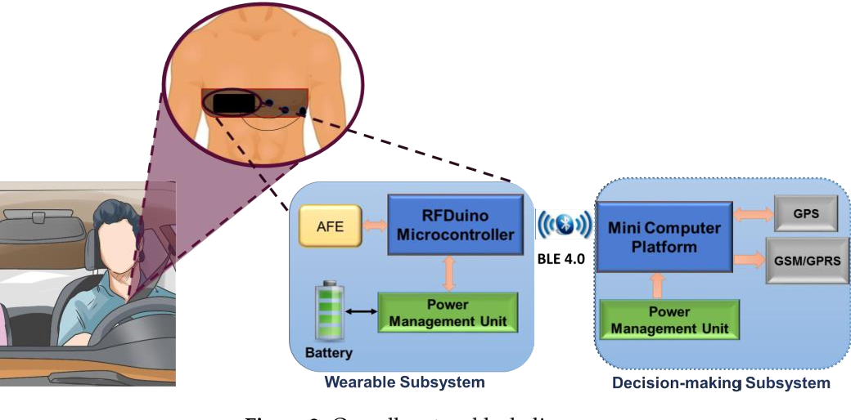
Prototype
Software : Machine Learning Modelling and deployment.
Hardware : Wearable Real-Time Heart Attack Detection Device
The system consists of two subsystems that communicate wirelessly using Bluetooth technology, namely, a wearable sensor subsystem and an intelligent heart attack detection and warning subsystem.
The sensor subsystem records the electrical
activity of the heart from the chest area to
produce electrocardiogram (ECG) trace and
send that to the other portable decision-making
subsystem where the symptoms of heart attack
are detected.
7
Notes:
Note:

Slide 12
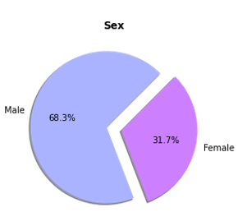
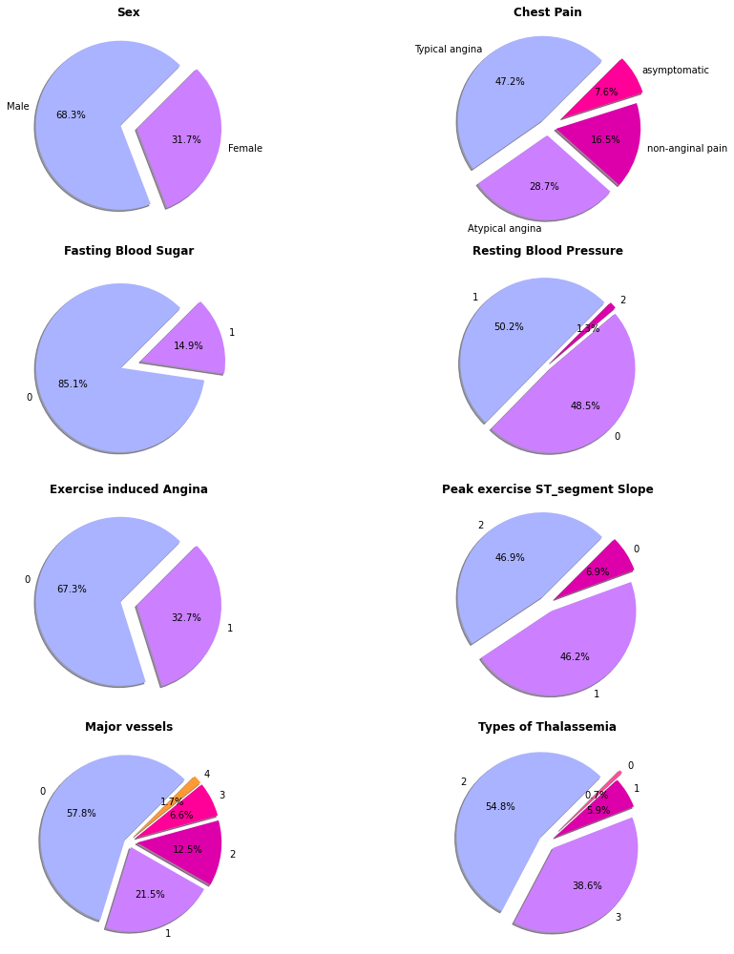
EDA
Angina is caused when there is not enough oxygen-rich blood flowing to a certain part of the heart. The arteries of the heart become narrow due to fatty deposits in the artery walls. The narrowing of arteries means that blood supply to the heart is reduced, causing angina.
8
Notes:
Note:

Slide 13
EDA
1 = true(> 120 mg/dl) & 0 = false
blood sugar taken after a long gap between a meal and the test. Typically, it's taken before any meal in the morning.
( pressure with no exercise )
0 = Normal
1 = Having ST Wave abnormality
2 = Probable or definite left ventricular hypertrophy
9
Notes:
Note:

Slide 14
EDA
(1 = yes & 0 = no)
Chest pain while exercising or doing any physical activity.
Value 1: upsloping
Value 2: flat
Value 3: downsloping
10
Notes:
Note:

Slide 15
EDA
Thalassemia is any of a group of hereditary hemolytic diseases caused by faulty hemoglobin synthesis, widespread in Mediterranean, African, and Asian countries.
0 = No Thalassemia
1= Normal
2= Fixed defect
3 = Reversable defect
11
Notes:
Note:

Slide 16
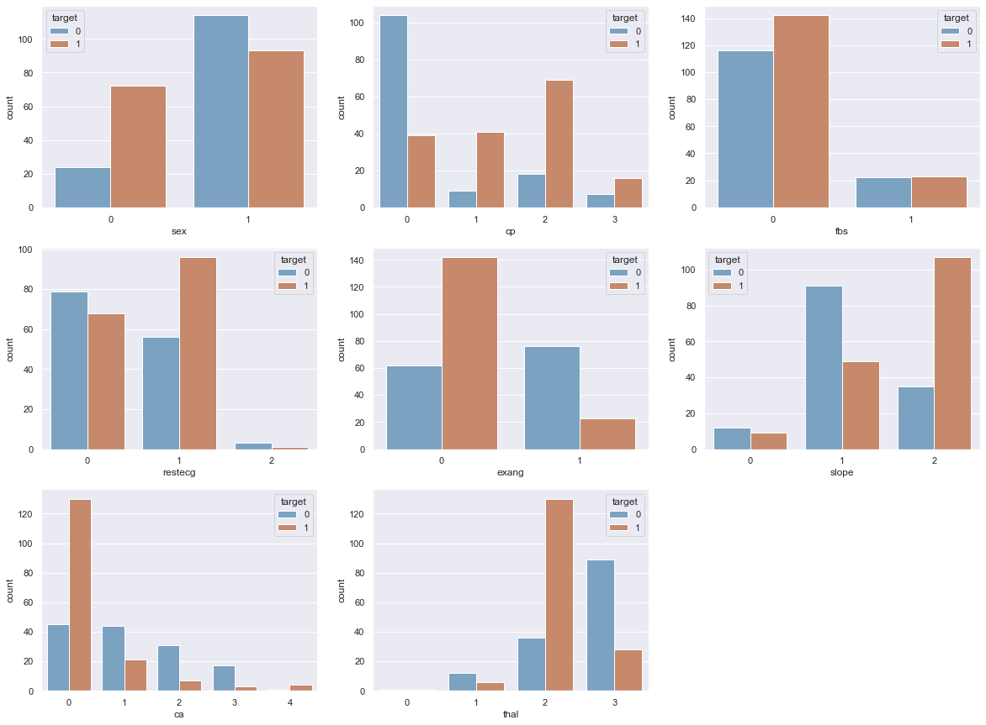
EDA
Relation between Features and Target
0 : typical angina
1 : atypical angina
2 : non-anginal pain
3 : asymptomatic
1=Male
0=Female
fasting blood sugar
( > 120 mg/dl )
12

Slide 17
EDA
Relation between Features and Target
The slope of the peak exercise ST segment
Value 0: upsloping
Value 1: flat
Value 2: downsloping
Resting electrocardiographic results
0 = Normal
1 = Having ST Wave abnormality
2 = Probable or definite left ventricular hypertrophy
Chest pain while exercising or doing any physical activity
13

Slide 18
EDA
Relation between Features and Target
Number of major vessels (0-3) colored by flourosopy
The Types of thalassemia
1 = normal
2 = fixed defect
3 = reversable defect
Thalassemia is any of a group of hereditary hemolytic diseases caused by faulty hemoglobin synthesis, widespread in Mediterranean, African, and Asian countries.

Slide 19
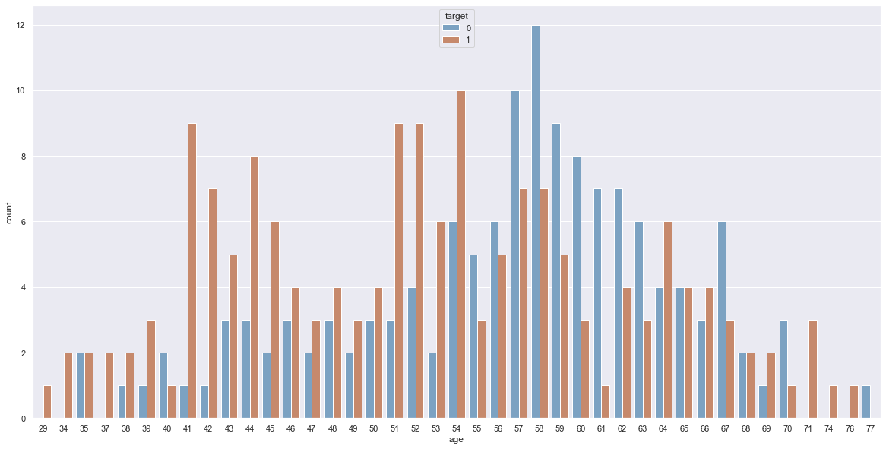
EDA
Relation between Continues Features and Target

Slide 20
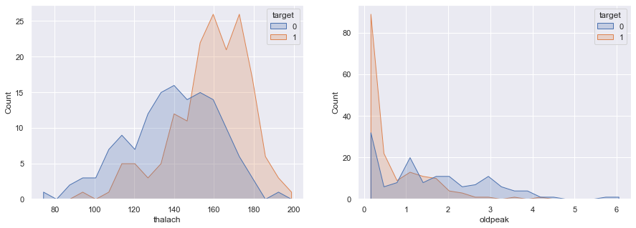
EDA
Relation between Continues Features and Target
Maximum heart rate achieved
ST depression induced by exercise relative to rest
ST Depression is the difference between value of ECG at rest and after exercise.
An electrocardiogram records the electrical signals in your heart. It's a common and painless test used to quickly detect heart problems and monitor your heart's health.

Slide 21
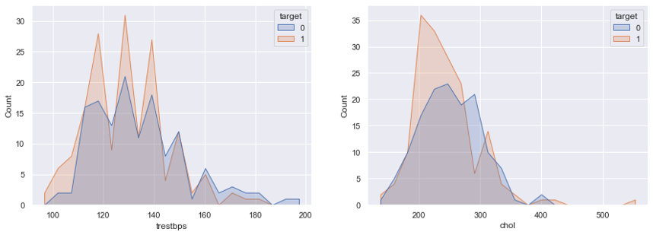
EDA
Relation between Continues Features and Target
Resting blood pressure
( Normal pressure with no exercise )
Serum cholestoral in mg/dl
Cholesterol means the blockage for blood supply in the blood vessels

Slide 22
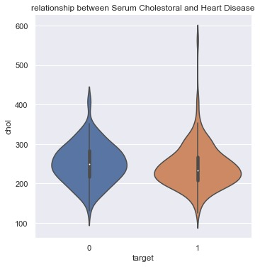
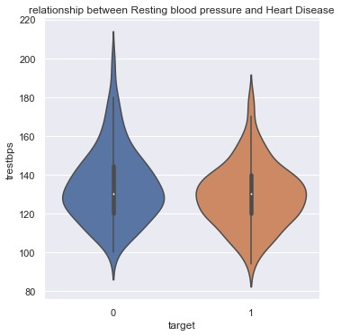
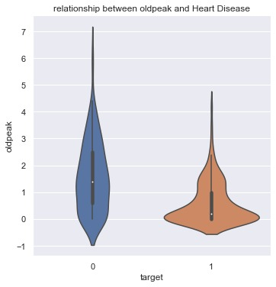
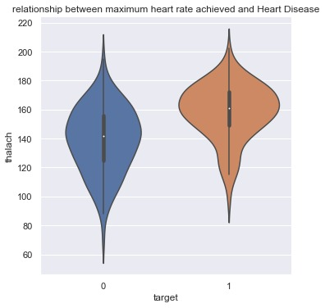
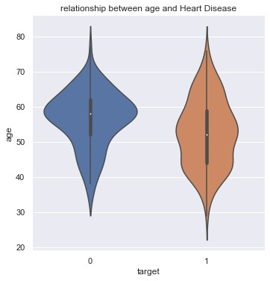
EDA
Relation between Continues Features and Target
2
Notes:
Note:

Slide 23
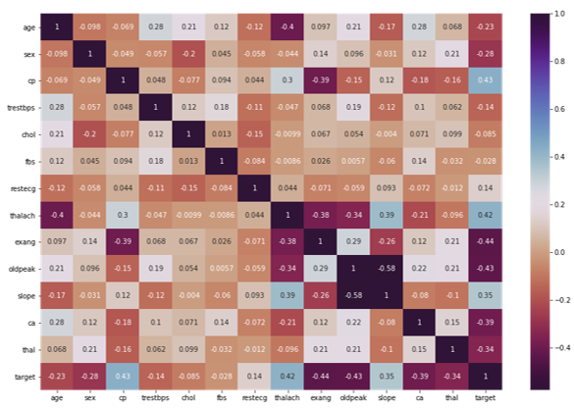
EDA
Correlation Between all Features

Slide 24
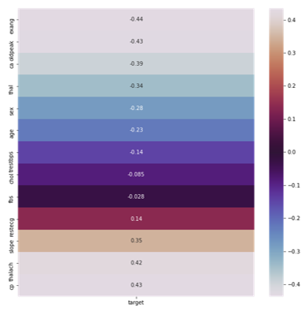
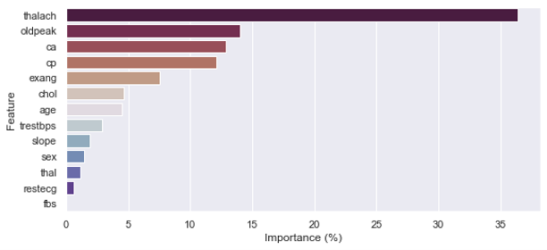
EDA
Feature Importance

Slide 25
Insights Conclusion
High-Risky Records (Mostly induced to have a heart disease)
sex : Male --> (1)
cp: Chest Pain ----→ Non-Anginal Pain ---> (2)
threstbps :Resting blood pressure ----→ 120-130-140
chol: serum cholestoral in mg/dl ---→ 200:300
fbs: fasting blood sugar > 120 mg/dl --→ Negative --> (0)
restecg: resting electrocardiographic results ---→ ST-Wave abnormality ----> (1)
thalach: maximum heart rate achieved ---→ 150:180
exang: exercise induced angina ---→ No Chest Pain --> (0)
oldpeak = difference between value of electrocardiogram records at rest and after exercise ---→ 0:1
slope: the slope of the peak exercise ST segment -----→ Downsloping ---> (2)
ca: number of major vessels (0-3) colored by flourosopy ---→ (0)
thal:The Types of thalassemia ----→ Reverseble Defect ----> (2)

Slide 26
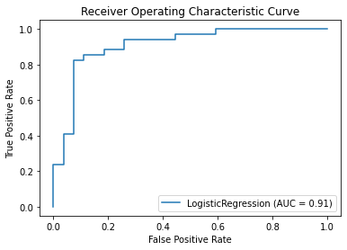
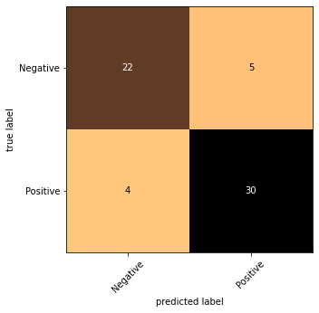
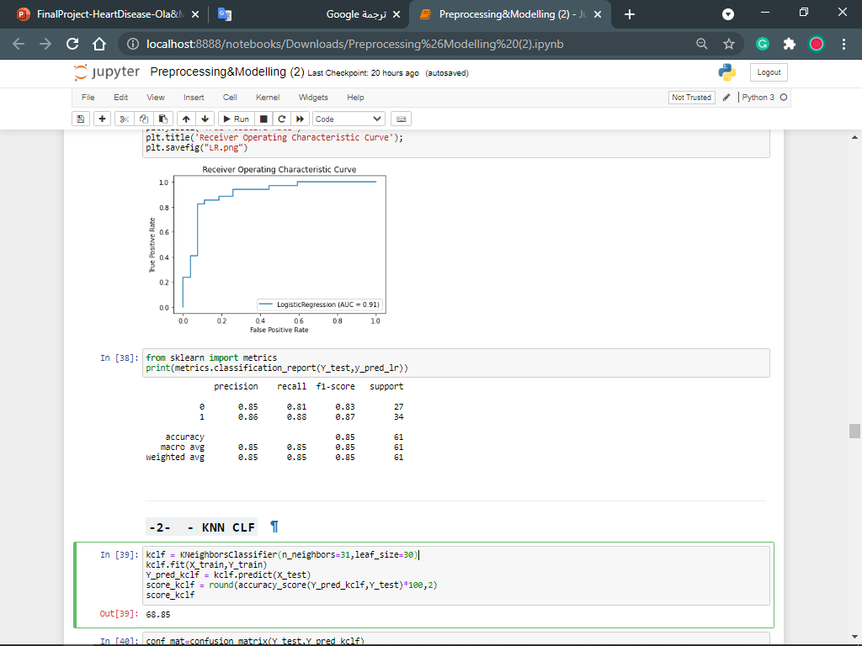
Modelling:
1-LogisticRegression
Notes:
Note:

Slide 27
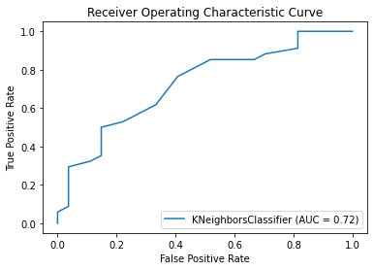
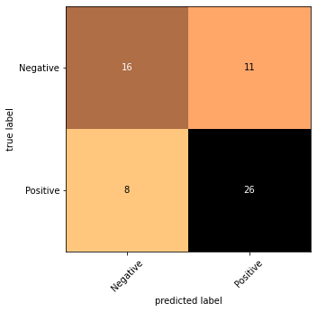
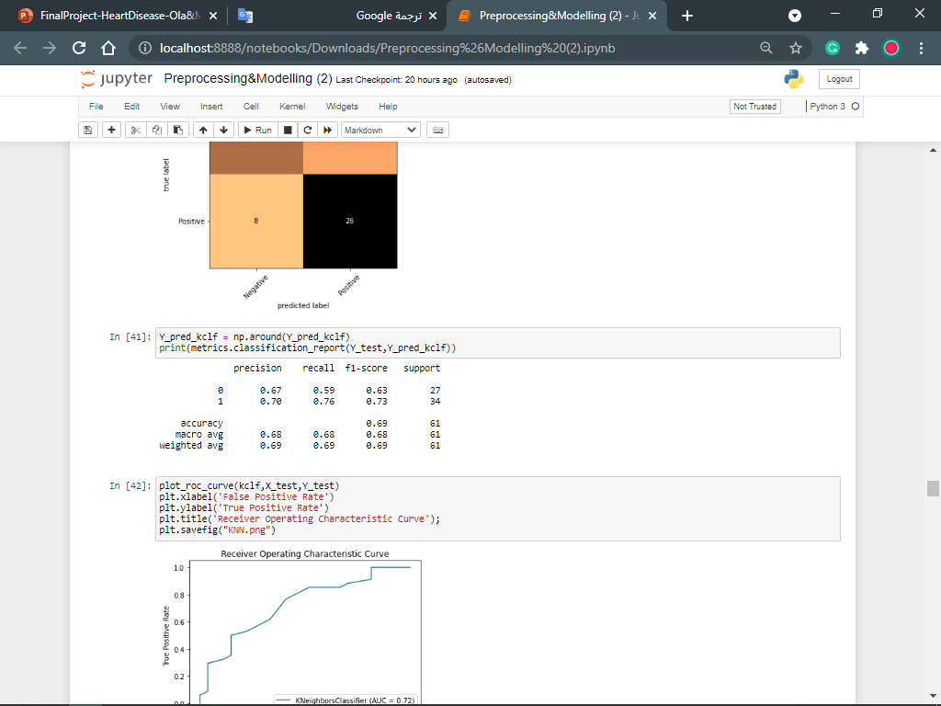
Modelling:
2- KNN CLF
Notes:
Note:

Slide 28
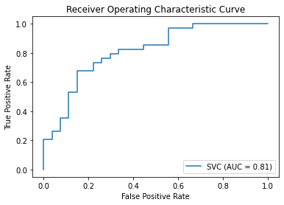
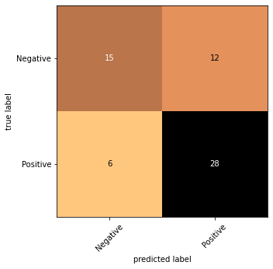
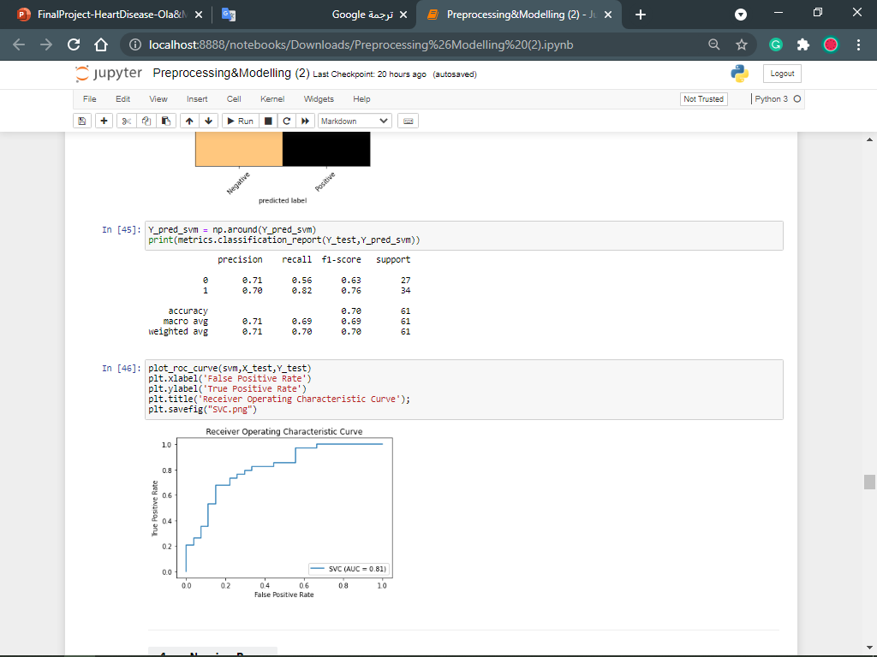
Modelling:
3- SVM
Notes:
Note:

Slide 29
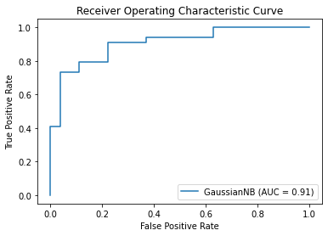

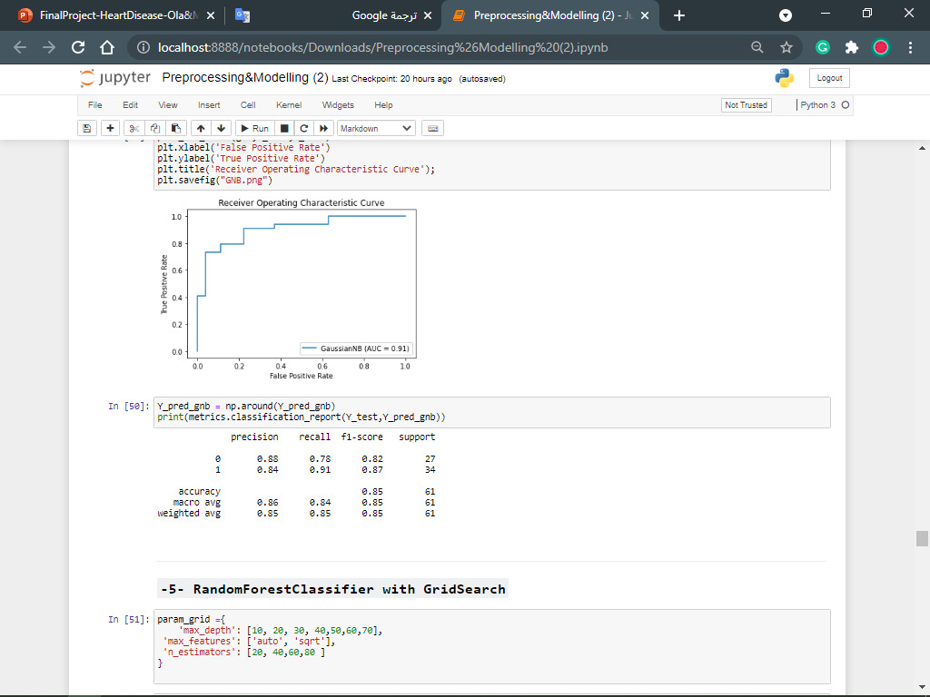
Modelling:
4- Naive Bayes
Notes:
Note:

Slide 30
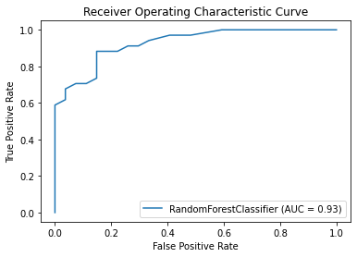
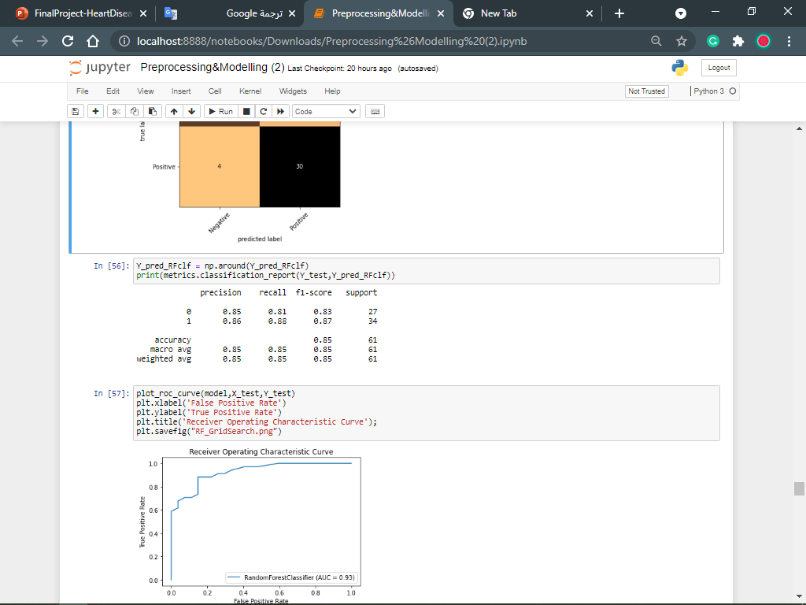
Modelling:
5- RandomForestClassifier with GridSearch
Notes:
Note:

Slide 31
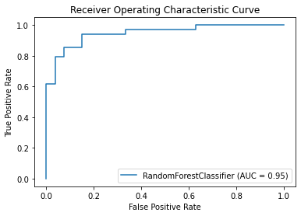
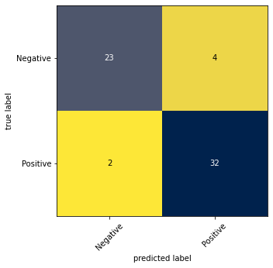
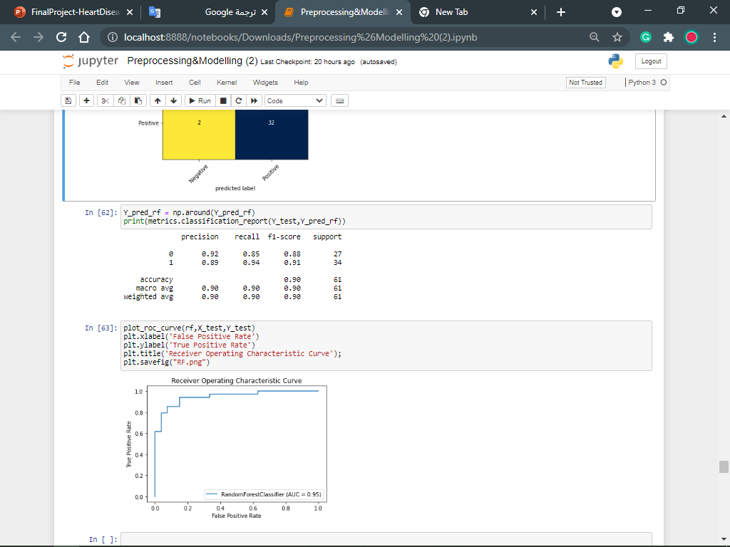
Modelling:
6- RandomForestClassifier
2
Notes:
Note:

Slide 32

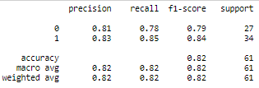
Modelling:
7- XGBoost
2
Notes:
Note:

Slide 33
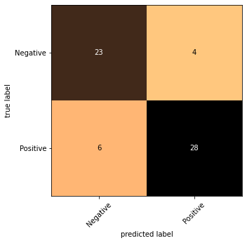
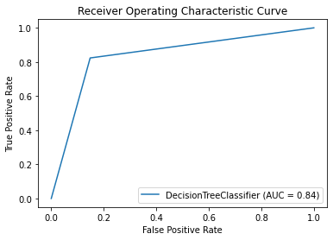
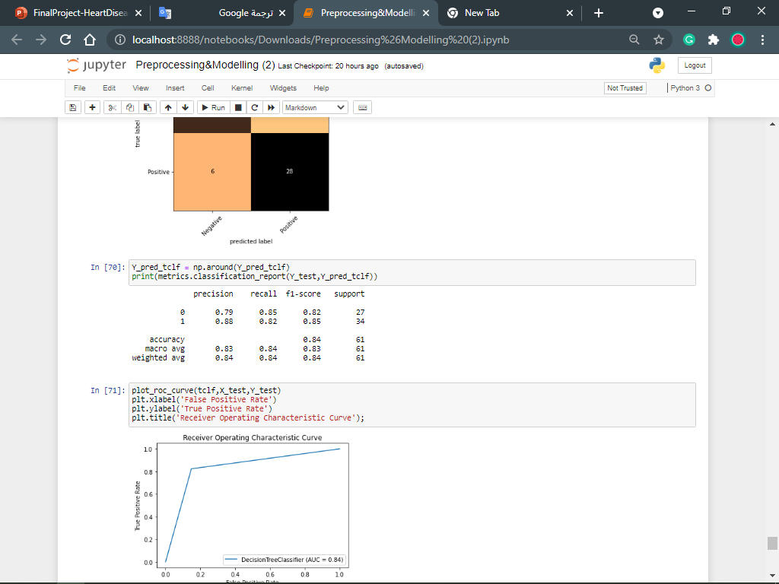
Modelling:
8- Decision Tree Classifier
Notes:
Note:

Slide 34
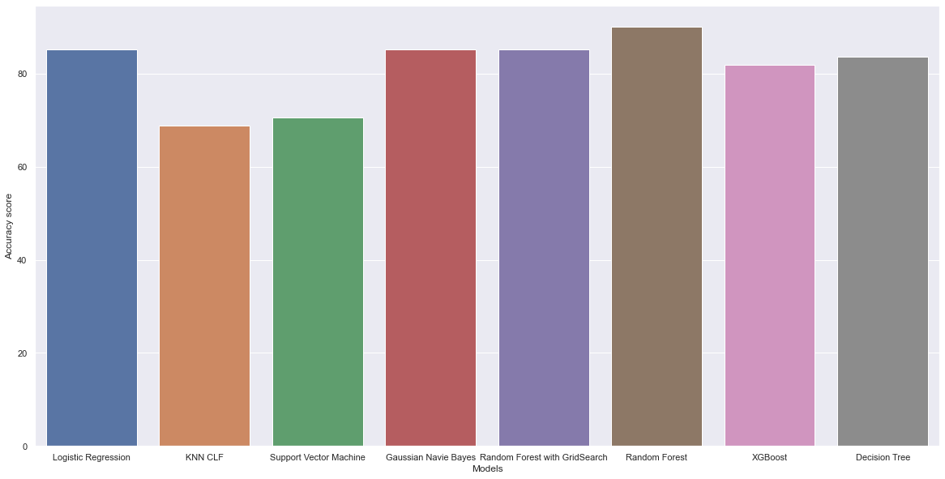
Though The Random forest Classifier gets the best result, We will use it as our main model to connect it's API with the GUI

Slide 35
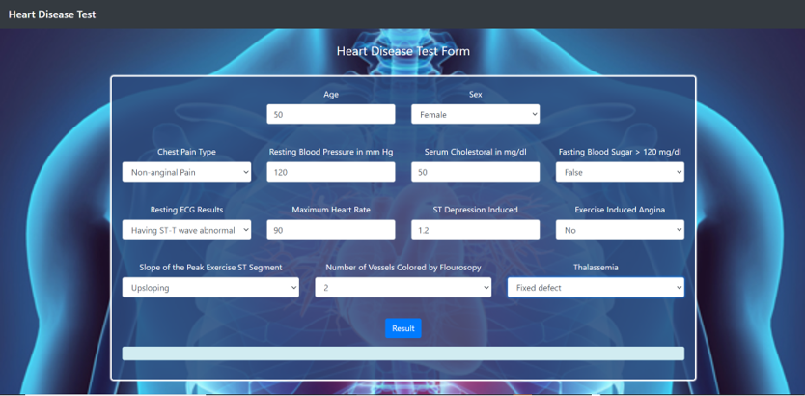
GUI​

Slide 36


Prediction Result
Positive Result :
Negative Result :

Slide 37
Recommendations
Follow these guidelines to keep your heart healthy:
Eat a balanced diet.
Maintain a reasonable body weight.
Stay at least moderately physically active, within any limits your cardiologist gives you.
Check your cholesterol level regularly, especially if your family has a history of heart disease.
Avoid smoking tobacco, using intravenous drugs, or taking street drugs. These behaviors are even riskier for you than for people without congenital heart disease.
Get regular medical care from your primary care physician. Even though you have a cardiologist, you still need a primary care doctor who is in charge of all your medical care.
Take care of your dental health. Regular dental care minimizes the chance of infections that could affect your heart. Your cardiologist will tell you if you need to take antibiotics, based on the type of heart disease that you have. See the section on Endocarditis for more information..

Slide 38
Recommendations
Following the recommendations of your cardiologist is important for keeping your heart healthy. These recommendations include:
Keep your follow-up appointments with your cardiologist.
Take your medicines as prescribed.
Make sure you have the necessary tests done when your doctor orders them.
Follow any physical activity recommendations and restrictions.
Talk with your cardiologist if you feel that a treatment or follow-up is making your feel worse or is unnecessary. Don't make any changes to your plan without consulting your doctor.
Check on possible side effects of over-the-counter medications, vitamins, herbal preparations or prescription medications before taking them. Discuss any potential cardiac side effects or drug interactions with your primary care physician, cardiologist or pharmacist.
Discuss your heart disease with your doctors before having a surgical procedure. Sometimes the surgery or anesthesia can affect your heart.

Slide 39
GitHub
https://github.com/olaelshiekh/Heart_Disease_detection
14
Notes:
Note:

Slide 40
Thanks :
DR: Doaa Mahmoud
Eng: Sayed Omar
Eng: Gehad Barakat
Eng: Shaimaa osman
Special thanks Eng: Mina Sameh
Honored to have any questions!
15
Notes:
Note:

